Slide 1

Scripting Interactivity - Mouse and Keyboard Input in Unity

Slide 2
Learning Objectives
Understand the role of mouse and keyboard input in game development.
Learn how to capture and respond to input in Unity.
Gain hands-on experience by scripting interactive elements

Slide 3
Content

Slide 4
Unity Input System Overview
The Input System allows your users to control your game or app using a device, touch, or gestures.
The Unity Input System is a modern and flexible system for handling input in Unity games and applications. It is designed to replace the legacy Input Manager and offers several advantages, including improved performance, flexibility, and support for a wide range of input devices.
The Input System is more extensible and provides a unified API for various input sources, making it easier to work with different platforms and devices.
Image source: Unity.com

Slide 5
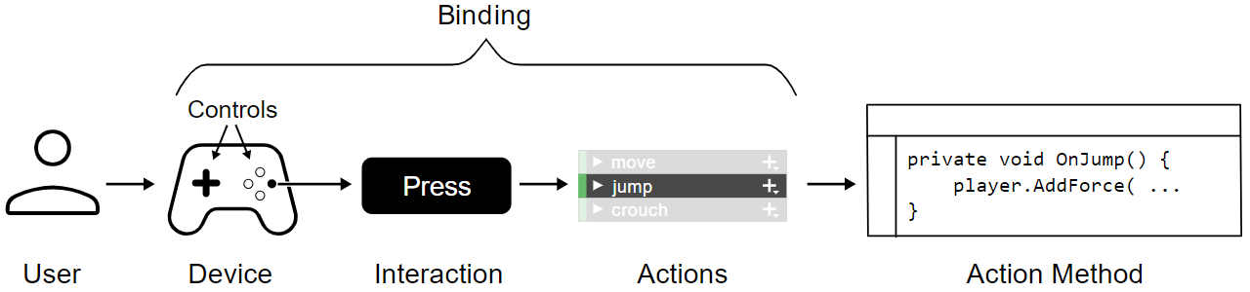
Input System Concepts
Basic concepts: These basic concepts and terms refer to the steps in the sequence of events that occur when a user sends input to your game or app. The Input System provides features which implement these steps, or you can choose to implement some of them yourself.
Image source: Unity.com

Slide 6
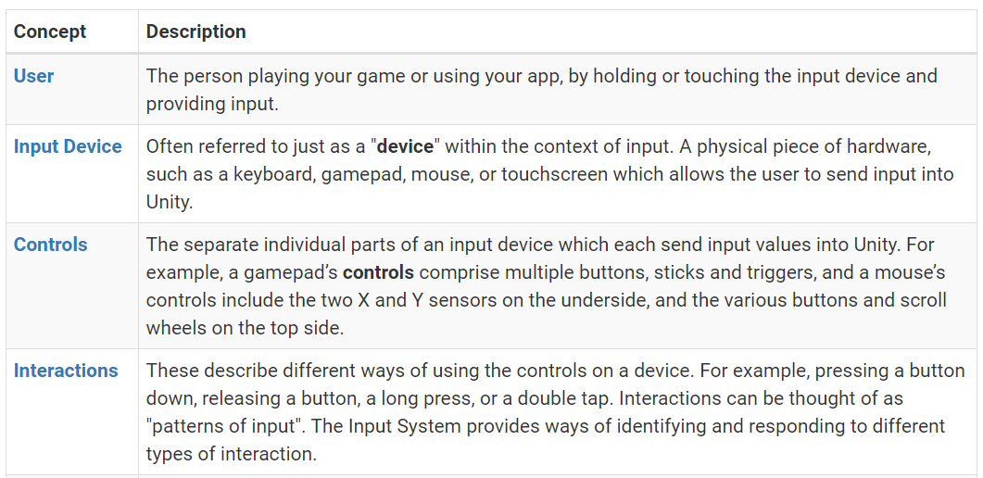
Input System Concepts
Image source: Unity.com

Slide 7
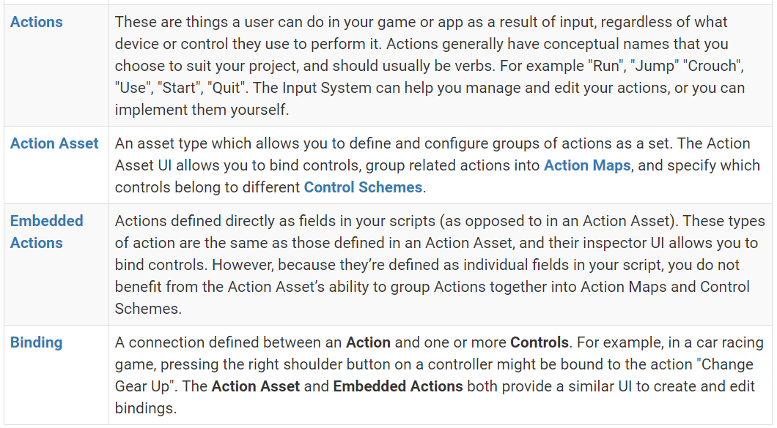
Input System Concepts
Image source: Unity.com

Slide 8
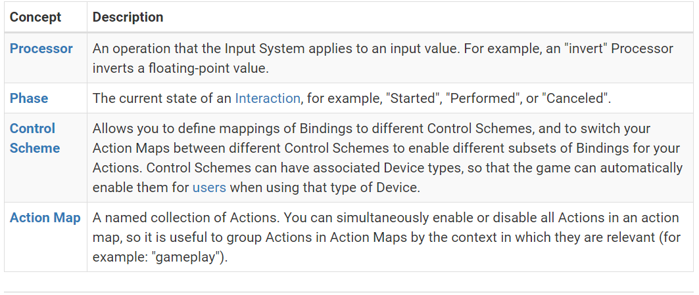
Input System Concepts
Extended concepts: These concepts relate to more advanced handling of input, and aren't necessary to understand straight away if you are implementing simple input, or learning about the system for the first time.
Image source: Unity.com

Slide 9
Input System Workflows
There are multiple ways to use the Input System, and the workflow that’s right for you depends on:
How quickly you want to get up and running,
How flexible you want your input code to be,
Whether you prefer to set things up in the Unity Editor, or in code.
4 main workflows:
Directly Reading Device States
Using Embedded Actions
Using an Actions Asset
Using an Actions Asset and a PlayerInput component
Image source: Unity.com

Slide 10
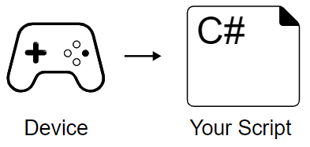
Input System Workflows
Directly Reading Device States:
This is the simplest and most direct workflow, but the least flexible. It’s useful if you want a quick implementation with one type of device. It might not be the best choice if you want to provide your users with multiple types of input or if you want to target multiple platforms.
Image source: Unity.com

Slide 11
Input System Workflows
Directly Reading Device States:
You can directly read the values from connected devices by referring to the device’s controls and reading the values they are currently generating, using code like this:
Image source: Unity.com

Slide 12
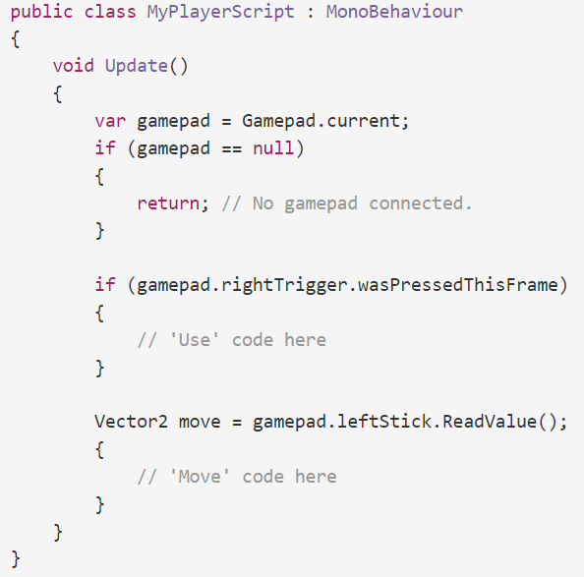
Input System Workflows
Directly Reading Device States:
Image source: Unity.com
Notes:
The example above reads values directly from the right trigger, and the left stick, of the currently connected gamepad. It does not use the input system’s "Action" class, and instead the conceptual actions in your game or app, such as "move" and "use", are implicitly defined by what your code does in response to the input. You can use the same approach for other Device types such as the keyboard or mouse.

Slide 13
Input System Workflows
Directly Reading Device States:
This is often the fastest way to set up some code which responds to input, but it is the least flexible because there is no abstraction between your code and the values generated by a specific device.
If you choose to use this technique:
You won’t benefit from Unity’s management of actions and interactions.
It is harder to make your game or app work with multiple types of input device.
Your input bindings are hard-coded in your script, so any changes to bindings require changes to the code.
It is harder to allow the user to remap their own controls to different actions at run time.
Image source: Unity.com

Slide 14
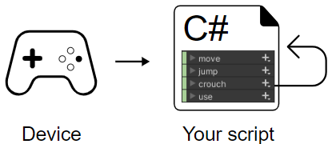
Input System Workflows
Using Embedded Actions:
You can use the InputAction class in your script to define actions in your script. This adds a layer of abstraction between your actual action code or methods, and the bindings to specific device controls.
You do not specify explicitly which controls (such as a gamepad trigger or stick) should do what in your code. Instead you create Actions, bind them to controls, and respond to the states or values from your Actions in your code.
Image source: Unity.com
Notes:
You can use the InputAction class in your script to define actions in your script. This adds a layer of abstraction between your actual action code or methods, and the bindings to specific device controls.
This means that instead of directly reading device states, you do not specify explicitly which controls (such as a gamepad trigger or stick) should do what in your code. Instead you create Actions, bind them to controls, and respond to the states or values from your Actions in your code.

Slide 15
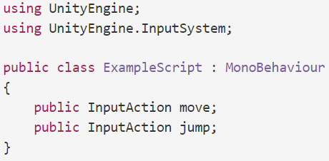
Input System Workflows
Using Embedded Actions:
When you make a public InputAction field in a MonoBehaviour script, it displays in the inspector as a configurable field. The configurable field UI allows you to create a binding for the action. For example, here are two Actions defined using the InputAction class in a script:
Image source: Unity.com

Slide 16
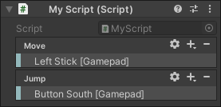
Input System Workflows
Using Embedded Actions:
In the image below, you can see the actions displayed in the inspector. In this example they have been configured so they are bound to Gamepad controls.
The InputAction class allows you to link device controls to named actions in the inspector, enabling flexible script design without hardcoded device references.
By enabling actions, you can read values through polling in your game loop or by adding event handlers, and disable actions when input-triggered event handling is no longer needed. This abstraction layer facilitates easy modification or addition of multiple bindings without code changes.
Image source: Unity.com
Notes:
The InputAction class provides a way to bind interactions from a device’s controls to named actions in the inspector. When you bind actions to controls from a device in the inspector, you can then design your script to respond when the actions are performed without hard-coding references to specific devices in your script. This layer of abstraction provides you with the flexibility to modify or add multiple bindings without needing to change your code.
To read values from your Actions, you must first enable the action, and then either repeatedly poll the action in your game loop, or add event handlers to the action. You must also disable the action when you no longer want the input to trigger event handlers.

Slide 17
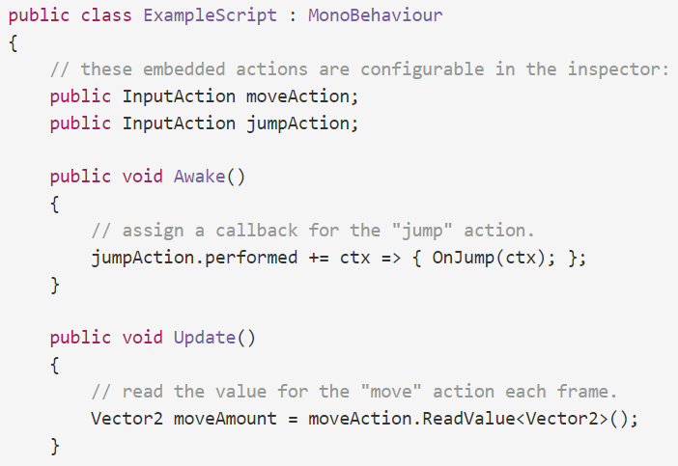
Input System Workflows
Using Embedded Actions:
Image source: Unity.com

Slide 18
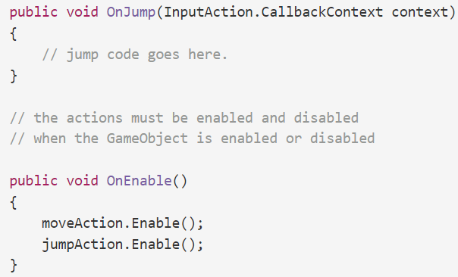
Input System Workflows
Using Embedded Actions:
Image source: Unity.com

Slide 19
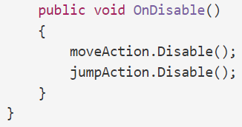
Input System Workflows
Using Embedded Actions:
Using InputActions also makes it easier to implement a system to allow the user to remap their own controls at run time.
Using embedded actions like this is more flexible than directly reading device states, but less flexible than using an actions asset.
Image source: Unity.com

Slide 20
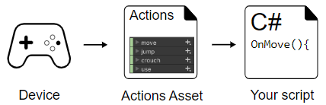
Input System Workflows
Using Actions Asset:
The Actions Asset provides a way to define, group, and manage sets of actions as data stored in an asset, instead of defining them directly in your code.
Using an Actions Asset allows you to keep the data that defines your actions separate from the GameObjects which should respond to the actions. This provides a further level of abstraction and organization, compared with embedding action definitions directly in your code.
Image source: Unity.com

Slide 21
Input System Workflows
Using Actions Asset:
The Actions Asset is useful because it means all your action definitions are stored as a single asset file, separate from your scripts and prefabs. This can make it simpler to manage conceptually, and can help in practical situations where different people in your team might work on different parts of the project at the same time.
Action Assets also provide other benefits over embedded actions in scripts, such as the ability to group actions into Action Maps and Control Schemes.
Image source: Unity.com

Slide 22
Input System Workflows
Using Actions Asset:
Action Maps are a way to group related actions together, where each map relates to a different situation. For example, your game might involve driving vehicles and navigating on foot, and may have in-game menus. In this example, it would make sense to have three different action maps for each of these three situations, and your game code would switch between them as appropriate. The actions grouped into the "driving" action map might be called "steer", "accelerate", "brake", "handbrake", etc, whereas the actions grouped into the "on foot" action map might be "move", "jump", "crouch", "use", etc.
Image source: Unity.com
Notes:
Action Maps are a way to group related actions together, where each map relates to a different situation. For example, your game might involve driving vehicles and navigating on foot, and may have in-game menus. In this example, it would make sense to have three different action maps for each of these three situations, and your game code would switch between them as appropriate. The actions grouped into the "driving" action map might be called "steer", "accelerate", "brake", "handbrake", etc, whereas the actions grouped into the "on foot" action map might be "move", "jump", "crouch", "use", etc

Slide 23
Input System Workflows
Using Actions Asset:
The Control Schemes, also defined in an Action Asset, allows you to specify which bindings belong to the control schemes you define. You might have one control scheme which is "Joypad", and another control scheme which is "Keyboard and Mouse". This allows you to determine which control scheme the user is currently using, so your game can respond to the user accordingly. This feature is often used to adapt the in-game UI to show the correct keys or buttons in on-screen prompts.
Image source: Unity.com
Notes:
The Control Schemes, also defined in an Action Asset, allows you to specify which bindings belong to the control schemes you define. You might have one control scheme which is "Joypad", and another control scheme which is "Keyboard and Mouse". This allows you to determine which control scheme the user is currently using, so your game can respond to the user accordingly. This feature is often used to adapt the in-game UI to show the correct keys or buttons in on-screen prompts.

Slide 24
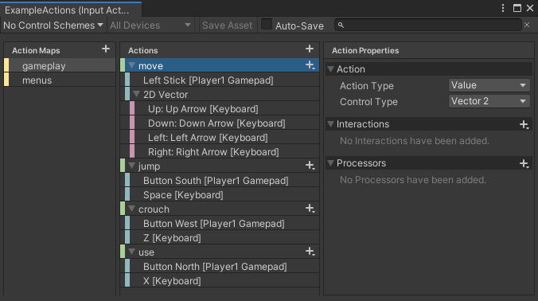
Input System Workflows
Using Actions Asset:
Image source: Unity.com
Notes:
The Control Schemes, also defined in an Action Asset, allows you to specify which bindings belong to the control schemes you define. You might have one control scheme which is "Joypad", and another control scheme which is "Keyboard and Mouse". This allows you to determine which control scheme the user is currently using, so your game can respond to the user accordingly. This feature is often used to adapt the in-game UI to show the correct keys or buttons in on-screen prompts.

Slide 25
Input System Workflows
Using Actions Asset:
When utilizing an Actions Asset, there are two ways to access it in your code:
through an inspector reference
by generating a C# class that serves as a wrapper for the Actions Asset.
The choice determines how you interact with actions in your code. With an inspector reference, actions are accessed by name using strings. Alternatively, using the Generate C# class feature creates a new .cs script asset that acts as a wrapper, allowing direct usage of API members named after your configured actions.
Image source: Unity.com
Notes:
When you use an Actions Asset, there are two distinct ways to access it from your code. You can either:
Use an inspector reference to the Actions Asset, or
Generate a C# class that wraps your Actions Asset.
Your choice affects how you access your actions from code. With an inspector reference to your Actions Asset, you must read the actions by name using strings. If you use the Generate C# class feature, Unity generates an accompanying class as a new .cs script asset, which acts as a wrapper for your actions. You can then create an instance of the generated wrapper class in your code and directly use its API members which are named after the names of the actions that you configured.

Slide 26
Input System Workflows
Using Actions Asset:
Referencing the Actions Asset in the inspector:
To use your Actions Asset through an inspector reference:
Create a public InputActionsAsset field in your script.
Assign the reference in the inspector.
Access the Actions in your script by name, using strings.
Image source: Unity.com
Notes:
When you use an Actions Asset, there are two distinct ways to access it from your code. You can either:
Use an inspector reference to the Actions Asset, or
Generate a C# class that wraps your Actions Asset.
Your choice affects how you access your actions from code. With an inspector reference to your Actions Asset, you must read the actions by name using strings. If you use the Generate C# class feature, Unity generates an accompanying class as a new .cs script asset, which acts as a wrapper for your actions. You can then create an instance of the generated wrapper class in your code and directly use its API members which are named after the names of the actions that you configured.

Slide 27
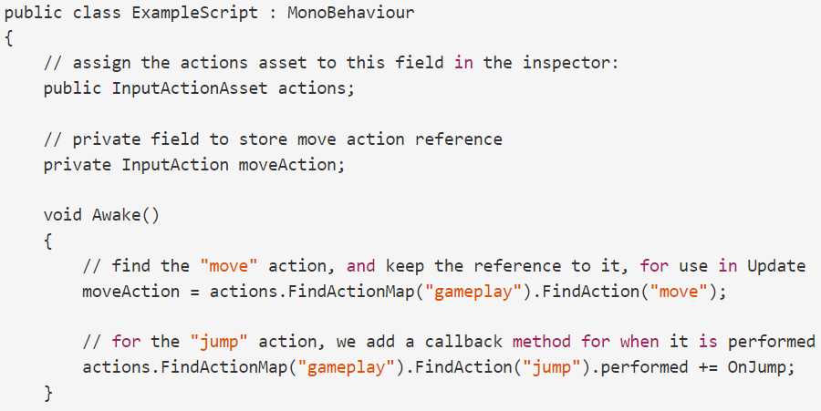
Input System Workflows
Using Actions Asset:
Image source: Unity.com

Slide 28
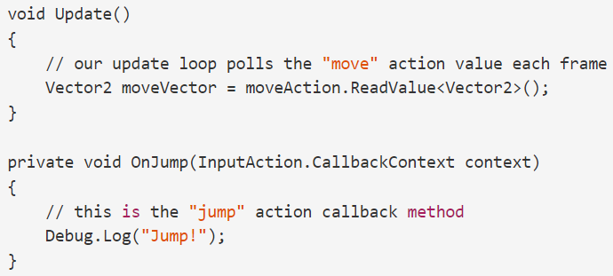
Input System Workflows
Using Actions Asset:
Image source: Unity.com

Slide 29
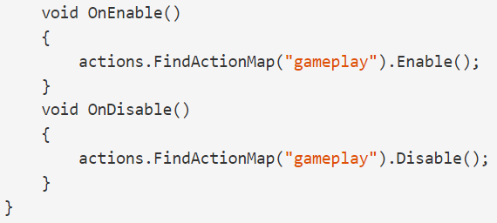
Input System Workflows
Using Actions Asset:
Note: In the example above the reference to the "move" action is stored in a variable after it is found, to avoid accessing it by string every frame, which would be bad for performance.
Image source: Unity.com

Slide 30
Input System Workflows
Using Actions Asset:
Referencing the Actions Asset through a C# wrapper
To use your Actions Asset through a C# wrapper:
Select your Actions Asset in the project window
In the Inspector, enable Generate C# Class and select Apply. You should see a C# asset with the same name as your Actions Asset in your project window.
Create an instance of your Actions C# class in your script.
Access the Actions in your script by using the API of your Actions C# class.
Image source: Unity.com

Slide 31
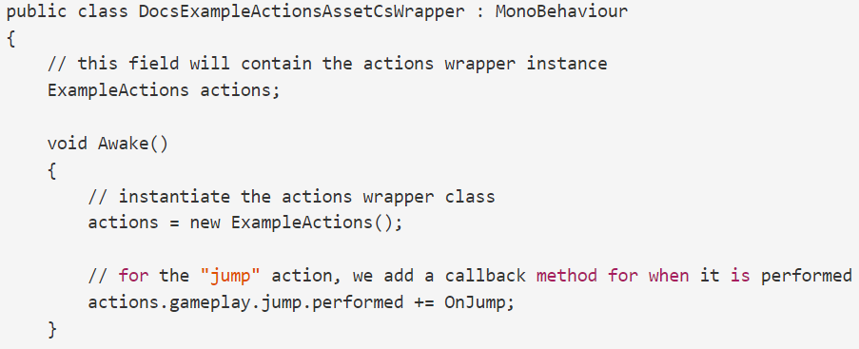
Input System Workflows
Using Actions Asset:
Referencing the Actions Asset through a C# wrapper
Image source: Unity.com

Slide 32
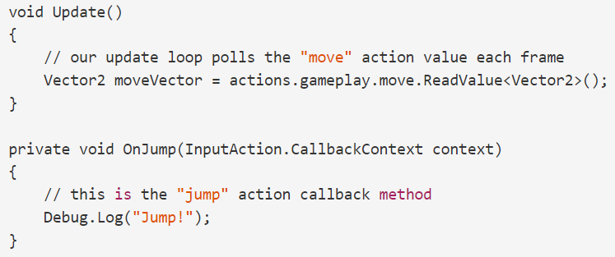
Input System Workflows
Using Actions Asset:
Referencing the Actions Asset through a C# wrapper
Image source: Unity.com

Slide 33
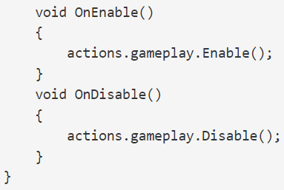
Input System Workflows
Using Actions Asset:
Referencing the Actions Asset through a C# wrapper
Image source: Unity.com

Slide 34
Input System Workflows
Using Actions Asset:
Referencing the Actions Asset through a C# wrapper
Whether you opt for the C# wrapper or inspector reference, using an Action Asset allows organized editing in the Actions Window. It offers flexibility compared to embedded actions and direct device state reading, making it a versatile solution for projects. For added abstraction, the Player Input component can be utilized to set up method calls based on Action definitions.
Image source: Unity.com
Notes:
Whether you use the C# wrapper option, or the inspector reference option, using an Action Asset like this gives you the ability to organize and edit your actions in the Actions Window. It is more flexible than using embedded actions, and directly reading device states, and is generally a good solution for many projects. However, you can also add one more step of abstraction using the Player Input component, to set up calls to methods based on your Action definitions.

Slide 35
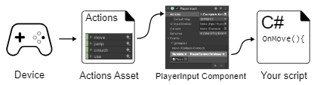
Input System Workflows
Using an Actions Asset and a PlayerInput component:
The highest abstraction level in the Input System involves using the Actions Asset and Player Input component together.
Player Input connects Actions from the asset to C# methods in your MonoBehaviour scripts, enabling the calling of these methods on user input.
The component facilitates connection setup through an inspector UI, eliminating the need to write code for these connections and providing flexibility in method invocation.
Image source: Unity.com
Notes:
The highest level of abstraction provided by the Input System is when you use the Actions Asset and the Player Input component together.
The Player Input component takes a reference to an Actions Asset, and provides a way to make connections between the Actions defined in that asset, and C# methods in your own MonoBehaviour scripts, so that your desired C# methods are called when the user performs an input action.
It allows you to set up these connections using a UI in the inspector, instead of requiring you to write code to make those connections (as shown in the previous workflow example), as well as letting you choose how those methods are called.

Slide 36
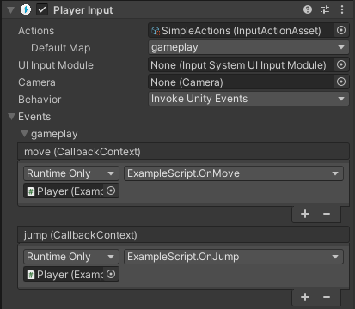
Input System Workflows
Using an Actions Asset and a PlayerInput component:
You would typically add the PlayerInput component to the same GameObject as your own MonoBehaviour script which contains the methods that should handle the response to the actions.
Image source: Unity.com
Notes:
The highest level of abstraction provided by the Input System is when you use the Actions Asset and the Player Input component together.
The Player Input component takes a reference to an Actions Asset, and provides a way to make connections between the Actions defined in that asset, and C# methods in your own MonoBehaviour scripts, so that your desired C# methods are called when the user performs an input action.
It allows you to set up these connections using a UI in the inspector, instead of requiring you to write code to make those connections (as shown in the previous workflow example), as well as letting you choose how those methods are called.

Slide 37
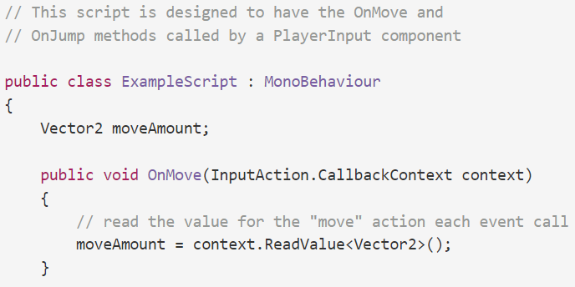
Input System Workflows
Using an Actions Asset and a PlayerInput component:
An example of the script which would provide an implementation of these methods
Image source: Unity.com

Slide 38
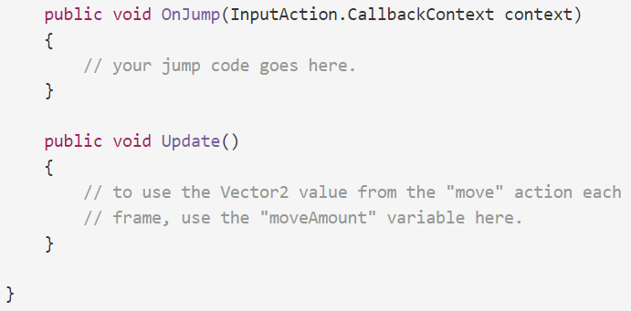
Input System Workflows
Using an Actions Asset and a PlayerInput component:
Image source: Unity.com

Slide 39
Input System Workflows
Using an Actions Asset and a PlayerInput component:
Compared to the previous workflow, this method involves less code by eliminating the need to reference the Actions Asset or set up event handler methods in your script. However, it requires more setup in the Editor and might complicate debugging due to non-hard-coded connections between actions and code.
The trade-off involves flexibility, simplicity, and implementation speed.
Player Input allows connecting any action to a public method without code, facilitating modifications without altering code. While requiring less code, coding connections in your script may be simpler and faster than managing them in a Player Input component on a GameObject.
Image source: Unity.com
Notes:
You can see compared with the previous workflow code example that this method requires less code, because you do not have to reference the Actions Asset or set up the event handler methods in your own script. However it does require more set-up in the Editor, and could make debugging more difficult because the connections between your actions and code are not hard-coded.
As with the other workflows described in this section, there is a trade-off between flexibility, simplicity, and speed of implementation.
Using the Player Input component provides the flexibility of being able to connect any action to any public method on a GameObject’s component without writing code, and allows you to make modifications to these connections without modifying code.
However, although requiring less code, you may find that coding the connections in your own script is simpler and faster than setting up and keeping track of these connections in a PlayerInput component on a GameObject.

Slide 40
Mouse Input
Mouse input can include various actions such as button clicks, movement, and scrolling. This part cover handling these actions using Unity's Input System.
Setting Up Input Actions:
Open the Unity Editor and create a new Input Actions asset or use an existing one.
Define input actions for mouse clicks, movement, and scrolling.
actions = new InputActionAsset();
actions.AddAction("LeftClick", binding: "<Mouse>/leftButton");
actions.AddAction("RightClick", binding: "<Mouse>/rightButton");
actions.AddAction("MousePosition", binding: "<Mouse>/position");
actions.AddAction("ScrollWheel", binding: "<Mouse>/scroll");
Image source: Unity.com

Slide 41
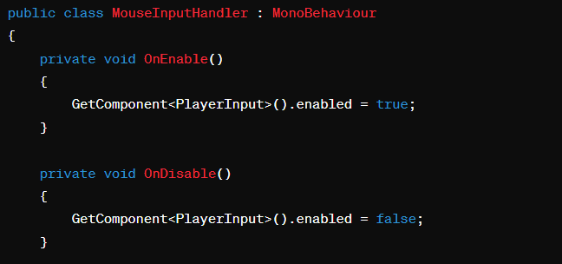
Mouse Input
Associating Input Actions with Script:
Create a C# script and associate it with a GameObject.
Use the PlayerInput component to associate the script with the Input Actions.
Image source: Unity.com

Slide 42
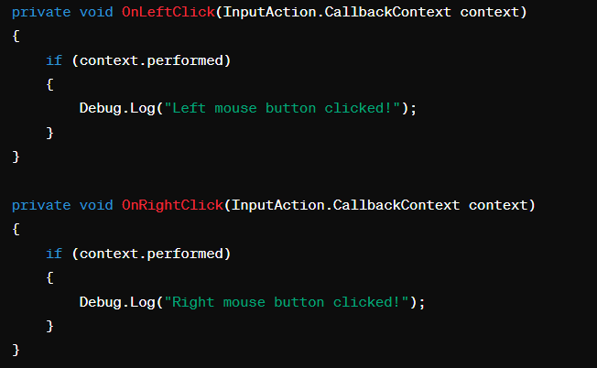
Mouse Input
Image source: Unity.com

Slide 43
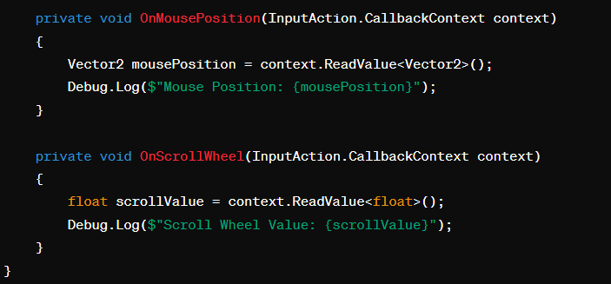
Mouse Input
Image source: Unity.com

Slide 44
Mouse Input
Handling Mouse Movement:
You can use the OnMousePosition method to track the mouse position. This is useful for tasks like aiming in a first-person shooter.
Handling Mouse Dragging:
To implement dragging, you can use a combination of OnMousePosition and mouse button actions.
Store the initial position on a button press and calculate the delta during the drag.
Handling Mouse Click and Hold:
Combine OnLeftClick and OnMousePosition to perform actions when the left mouse button is clicked and held.
Customizing Mouse Input:
Adjust sensitivity, invert controls, or add dead zones by modifying the Input Actions and associated methods.
Image source: Unity.com

Slide 45
Mouse Input
Implementing Custom Cursors:
Change the mouse cursor appearance based on the game state or interaction.ter.
Using Raycasting for Interaction:
For 3D games, use raycasting from the mouse position to interact with objects in the world.
Handling Mouse Input in UI:
Unity's UI system has specific methods for handling mouse input on UI elements..
Performance Considerations:
Be mindful of performance when handling mouse input in the Update method. Consider using InputAction events for more optimized handling.
Image source: Unity.com

Slide 46
Mouse Input
Testing and Debugging:
Test mouse input on different platforms and devices.
Utilize Unity's debugging tools to visualize input events.
Image source: Unity.com

Slide 47
Mouse Input
Example 1: Detecting Left Mouse Click
using UnityEngine;
using UnityEngine.InputSystem;
public class MouseClickExample : MonoBehaviour
{
private void OnEnable()
{
// Enable the PlayerInput component
GetComponent<PlayerInput>().enabled = true;
}
private void OnDisable()
{
// Disable the PlayerInput component
GetComponent<PlayerInput>().enabled = false;
}
private void OnLeftClick(InputAction.CallbackContext context)
{
if (context.performed)
{
Debug.Log("Left mouse button clicked!");
}
}
}
Image source: Unity.com

Slide 48
Mouse Input
Example 2: Tracking Mouse Position
using UnityEngine;
using UnityEngine.InputSystem;
public class MousePositionExample : MonoBehaviour
{
private void OnEnable()
{
// Enable the PlayerInput component
GetComponent<PlayerInput>().enabled = true;
}
private void OnDisable()
{
// Disable the PlayerInput component
GetComponent<PlayerInput>().enabled = false;
}
private void OnMousePosition(InputAction.CallbackContext context)
{
Vector2 mousePosition = context.ReadValue<Vector2>();
Debug.Log($"Mouse Position: {mousePosition}");
}
}
Image source: Unity.com

Slide 49
Mouse Input
Example 4: Mouse Dragging
using UnityEngine;
using UnityEngine.InputSystem;
public class MouseDraggingExample : MonoBehaviour
{
private bool isDragging = false;
private Vector2 initialMousePosition;
private void OnEnable()
{
// Enable the PlayerInput component
GetComponent<PlayerInput>().enabled = true;
}
private void OnDisable()
{
// Disable the PlayerInput component
GetComponent<PlayerInput>().enabled = false;
}
Image source: Unity.com

Slide 50
Mouse Input
Example 4: Mouse Dragging
private void OnLeftClick(InputAction.CallbackContext context)
{
if (context.performed)
{
isDragging = true;
initialMousePosition = Mouse.current.position.ReadValue();
}
else if (context.canceled)
isDragging = false;
}
private void OnMousePosition(InputAction.CallbackContext context)
{
if (isDragging)
{
Vector2 currentMousePosition = context.ReadValue<Vector2>();
Vector2 dragDelta = currentMousePosition - initialMousePosition;
// Use dragDelta for dragging logic
Debug.Log($"Mouse Drag Delta: {dragDelta}");
}
}
}
Image source: Unity.com

Slide 51
Keyboard Input
Scripting for keyboard input in Unity involves using the Unity Input System to detect and respond to key presses, releases, and other keyboard-related events. The Unity Input System provides a flexible and unified way to handle various input devices, including keyboards. an overview of scripting for keyboard input in Unity:
Enabling the Input System:
Ensure that the Unity Input System package is installed in your project. You can do this using the Unity Package Manager.
Creating Input Actions:
Open the Unity Editor and navigate to "Window" > "Input Actions" to create a new Input Actions asset.
Define input actions for keyboard events such as key presses, releases, and combinations.
Image source: Unity.com

Slide 52
Keyboard Input
Associating Input Actions with Scripts:
Create a C# script that will handle the keyboard input.
Use the PlayerInput component to associate the script with the Input Actions.
Defining Callback Methods:
Define methods in your script to handle specific keyboard events. These methods will be triggered when the associated input actions occur.
Callback methods often start with "On" followed by the type of event (e.g., OnKeyPress, OnKeyRelease).
Reading Input Values:
Use the context.ReadValue method to read input values in your callback methods.
For key presses, you might use context.performed. For key releases, you might use context.canceled.
Image source: Unity.com

Slide 53
Keyboard Input
Handling Specific Keys:
To handle specific keys, you can check the name of the input action in your callback methods.
For example, to handle the "W" key: if (context.action.name == "W").
Handling Key Combinations:
You can set up input actions for key combinations and respond to them in your callback methods.
For example, a combination of "Ctrl" + "C" can be handled by checking both keys in your method.
Managing Key Holding:
Use the context.performed and context.canceled checks to determine when a key is held down or released.
For continuous actions, use context.started and context.performed.
Image source: Unity.com

Slide 54
Keyboard Input
Testing and Debugging:
Test your keyboard input scripts in the Unity Editor and ensure they respond as expected.
Use Debug.Log statements to print information during testing.
Image source: Unity.com

Slide 55
Keyboard Input
Example 1: Simple Key Press
using UnityEngine;
using UnityEngine.InputSystem;
public class KeyPressExample : MonoBehaviour
{
private void OnEnable()
{
// Enable the PlayerInput component
GetComponent<PlayerInput>().enabled = true;
}
private void OnDisable()
{
// Disable the PlayerInput component
GetComponent<PlayerInput>().enabled = false;
}
private void OnKeyPress(InputAction.CallbackContext context)
{
if (context.performed)
{
Debug.Log("Key pressed!");
}
}
}
Image source: Unity.com

Slide 56
Keyboard Input
Example 2: Specific Key Press
using UnityEngine;
using UnityEngine.InputSystem;
public class SpecificKeyPressExample : MonoBehaviour
{
private void OnEnable()
{
// Enable the PlayerInput component
GetComponent<PlayerInput>().enabled = true;
}
private void OnDisable()
{
// Disable the PlayerInput component
GetComponent<PlayerInput>().enabled = false;
}
Image source: Unity.com

Slide 57
Keyboard Input
Example 2: Specific Key Press
private void OnSpecificKeyPress(InputAction.CallbackContext context)
{
if (context.performed && context.ReadValue<float>() > 0.5f)
{
// Check for a specific key (e.g., W key)
if (context.action.name == "W")
{
Debug.Log("W key pressed!");
}
}
}
}
Image source: Unity.com

Slide 58
Keyboard Input
Example 3: Key Release
using UnityEngine;
using UnityEngine.InputSystem;
public class KeyReleaseExample : MonoBehaviour
{
private void OnEnable()
{
// Enable the PlayerInput component
GetComponent<PlayerInput>().enabled = true;
}
private void OnDisable()
{
// Disable the PlayerInput component
GetComponent<PlayerInput>().enabled = false;
}
private void OnKeyRelease(InputAction.CallbackContext context)
{
if (context.performed)
{
Debug.Log("Key released!");
}
}
}
Image source: Unity.com

Slide 59
Keyboard Input
Example 4: Key Holding
using UnityEngine;
using UnityEngine.InputSystem;
public class KeyHoldingExample : MonoBehaviour
{
private bool isKeyHeld = false;
private void OnEnable()
{
// Enable the PlayerInput component
GetComponent<PlayerInput>().enabled = true;
}
private void OnDisable()
{
// Disable the PlayerInput component
GetComponent<PlayerInput>().enabled = false;
}
Image source: Unity.com

Slide 60
Keyboard Input
Example 4: Key Holding
private void OnKeyHold(InputAction.CallbackContext context)
{
if (context.performed)
{
isKeyHeld = true;
Debug.Log("Key held down!");
}
else if (context.canceled)
{
isKeyHeld = false;
Debug.Log("Key released!");
}
}
}
Image source: Unity.com

